Slide 1

Sparksql and dataframes
Spring 2026
Dr Mayada Hadhoud

Slide 2
outline
Structured Data Processing in Spark
Spark Dataframe
Why Dataframe?
Dataframes vs. RDD
Dataframe Operations
Spark SQL Query Optimization

Slide 3
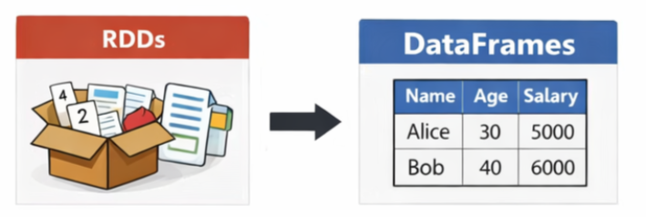
Structured data processing in spark
Structured APIs (DataFrames and Datasets) introduced in Spark 1.3 to simplify data analytics and enable automatic optimization.
Why Structured APIs?
Represent data as tables with named columns and types.
Enable schema awareness for better optimization.
Built on top of RDDs but simplify code and improve performance.
Limitations of RDDs
Verbose code for simple queries.
No automatic query optimization.
Harder integration with SQL.
Notes:
Show a simple RDD word count vs. a DataFrame query — learners will immediately see the difference in readability.
Apache Parquet is an open-source, columnar storage file format designed for efficient data processing and is the default storage format for Apache Spark [1, 20].
Why Structured APIs?
RDDs lack schema awareness → difficult optimization.
Structured APIs (DataFrames, Datasets) introduced in Spark 1.3 to simplify analytics.
Limitations of RDDs:
Verbose code for simple queries.
No automatic query optimization.
Harder integration with SQL.
RDD (Resilient Distributed Dataset) is Spark’s original abstraction.
It represents a distributed collection of objects across the cluster.
RDDs themselves are unstructured — they don’t carry schema information (no column names or data types).
You can store structured data inside an RDD (e.g., tuples like (id, name, age)), but Spark doesn’t “know” the structure — it just sees generic objects.
Limitations of RDD-based Processing:
No Schema Awareness: RDDs treat data as a "black box" of generic objects.
Manual Optimization Only: Because Spark cannot "peek" into the RDD, it cannot automatically optimize the sequence of transformations. All responsibility for performance falls on the developer
"How" Coding: Developers must program the low-level logic of how to process the data, not just what results they want
Difficulty with SQL: Integrating traditional SQL queries or external tools with low-level RDDs requires complex conversion logic.
RDD cannot be optimized by Spark — they are fully lambda-driven. RDD is rather a "black box" of data, which cannot be optimized because Spark can't look inside what the data actually consists of. So Spark can't do any optimizations on your behalf. This feels more acute in non-JVM languages such as Python.
DataFrame has additional metadata due to its column format, which allows Spark to perform certain optimizations on a completed request. Before your query is run, a logical plan is created using Catalyst Optimizer and then it's executed using the Tungsten execution engine.
The code in RDD expresses more how of a solution better than what. It is a bit difficult to read the code based on RDD and understand what is going on.
Using DataFrame API it's easy to go one level up — to business logic. Since DataFrame API looks like SQL and there is a schema, it's easy to see the real work with data. So, using DataFrame API, you are closer to what you are trying to achieve and not to how you are doing it.

Slide 4
Spark dataframe
What is Dataframe?
A DataFrame is a structured, distributed dataset with schema, providing a high-level abstraction and optimized processing for big data.
Key Idea
Data is structured like a table
DataFrame is similar to:
Relational database table
Python pandas DataFrame
SQL table
Dataframe Advantages:
Easy to understand
Easy to query using SQL like code
Familiar to most users
Simply, Dataframe is a relational table with good optimization technique.
Notes:
We can build DataFrame from different data sources. For Example structured data file, tables in Hive, external databases or existing RDDs.

Slide 5
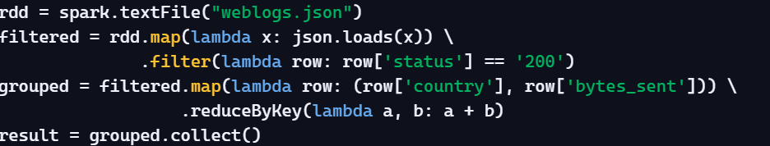
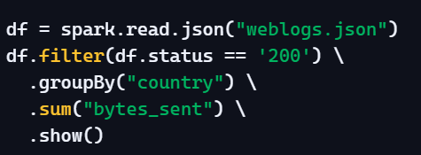
RDD vs dataframe code
RDD API
Low‑level, manual, verbose, less optimized.
DataFrame API
High‑level, declarative, concise, automatically optimized
Notes:
RDD Code Explanation:
Reads the JSON file as raw text.
Manually parses each line into JSON.
Filters rows where status == '200'.
Maps each row into (country, bytes_sent) pairs.
Aggregates with reduceByKey to sum bytes per country.
Collects results back to the driver.
Dataframe Code Explanation
Reads the JSON file directly into a DataFrame (schema inferred).
Filters rows where status == '200'.
Groups by country.
Sums bytes_sent.
Displays results with .show().

Slide 6
Spark dataframe
Dataframe Characteristics
Structured Data → Works with tabular data
Schema-based → Every column has a defined type
Distributed → Data is split across multiple nodes
Immutable → Cannot modify → create new DataFrame
Notes:
We can build DataFrame from different data sources. For Example structured data file, tables in Hive, external databases or existing RDDs.

Slide 7
Why dataframe?
DataFrame is one step ahead of RDD (Higher Level Abstraction).
RDD is a collection of generic objects, a DataFrame is like a distributed table with named columns and data types (a "Schema").
Dataframe introduces structure to distributed data. This structured view allows Spark to "peek" into your data and apply clever optimizations that are impossible with the "black box" nature of RDDs.
Dataframes enabled developers to focus on “What” to process instead of “How” to process it (low level programming)
Notes:
This structured view is what allows Spark to "peek" into your data and apply clever optimizations that are impossible with the "black box" nature of RDDs.
DataFrame API ↓ Optimized Plan ↓ RDD Execution
DataFrames provide higher abstraction, but execution still happens using RDDs internally
all high-level APIs eventually translate down to RDD-based execution at the task level.
High-Level APIs Are Just Front Ends Whether you use the DataFrame API, Dataset API, or Spark SQL, these are simply abstractions designed to make development easier and more expressive. At execution time, Spark does not differentiate between them they all follow the same underlying execution model.
Strategic Purpose and Value of DataFrames
Higher Level Abstraction:The major contribution of DataFrames is providing a Higher Level Abstraction for developers.
Why Abstraction Matters: Instead of programming at the low level of "how" to process individual bytes (like with RDD Pair transformations), you focus on "what" to process (e.g., "Select 'CustomerName', Join 'Products'").
Processing Capabilities: The DataFrame API is specifically designed for efficiently processing large amounts of structured and semi-structured data.
Imposing Structure: Spark enables you to impose structure onto any distributed collection of data (like JSON or CSV), unlocking rich relational and SQL-like capabilities.

Slide 8
Why dataframe?
The DataFrame API provides two critical low-level enhancements:
a. Custom Memory Management (Project Tungsten): reduces RAM usage and garbage collection overhead.
b. Optimized Execution Plans (Catalyst Optimizer): Automatically determines the fastest way to run your query before any data is processed.
Notes:
This structured view is what allows Spark to "peek" into your data and apply clever optimizations that are impossible with the "black box" nature of RDDs.
Tungsten turns Spark into a database-like engine, not just a collection of Java objects.
DataFrame API ↓ Optimized Plan ↓ RDD Execution
DataFrames provide higher abstraction, but execution still happens using RDDs internally
all high-level APIs eventually translate down to RDD-based execution at the task level.
High-Level APIs Are Just Front Ends Whether you use the DataFrame API, Dataset API, or Spark SQL, these are simply abstractions designed to make development easier and more expressive. At execution time, Spark does not differentiate between them they all follow the same underlying execution model.
Strategic Purpose and Value of DataFrames
Higher Level Abstraction:The major contribution of DataFrames is providing a Higher Level Abstraction for developers.
Why Abstraction Matters: Instead of programming at the low level of "how" to process individual bytes (like with RDD Pair transformations), you focus on "what" to process (e.g., "Select 'CustomerName', Join 'Products'").
Processing Capabilities: The DataFrame API is specifically designed for efficiently processing large amounts of structured and semi-structured data.
Imposing Structure: Spark enables you to impose structure onto any distributed collection of data (like JSON or CSV), unlocking rich relational and SQL-like capabilities.

Slide 9
Dataframe vs rdd
Both DataFrame and RDD are:
In-Memory: Active caching for speed.
Resilient: Fault tolerant via lineage recovery.
Distributed: Scalable parallel processing.
Immutable: Locked-down, functional data objects.
Feature | RDD | DataFrame | SQL
Schema | None | Yes | Yes
Optimization | Manual | Automatic | Automatic
Syntax | Verbose | Concise | Familiar
Performance | Lower | Higher | Higher
Notes:
Performance Optimization: Catalyst + Tungsten engine.
Memory Efficiency: Columnar storage, reduced overhead.
Simpler Syntax: SQL-like operations instead of verbose RDD code.
While RDD is a "black box" of data, a DataFrame acts as a Relational Table with good optimization techniques already applied.

Slide 10
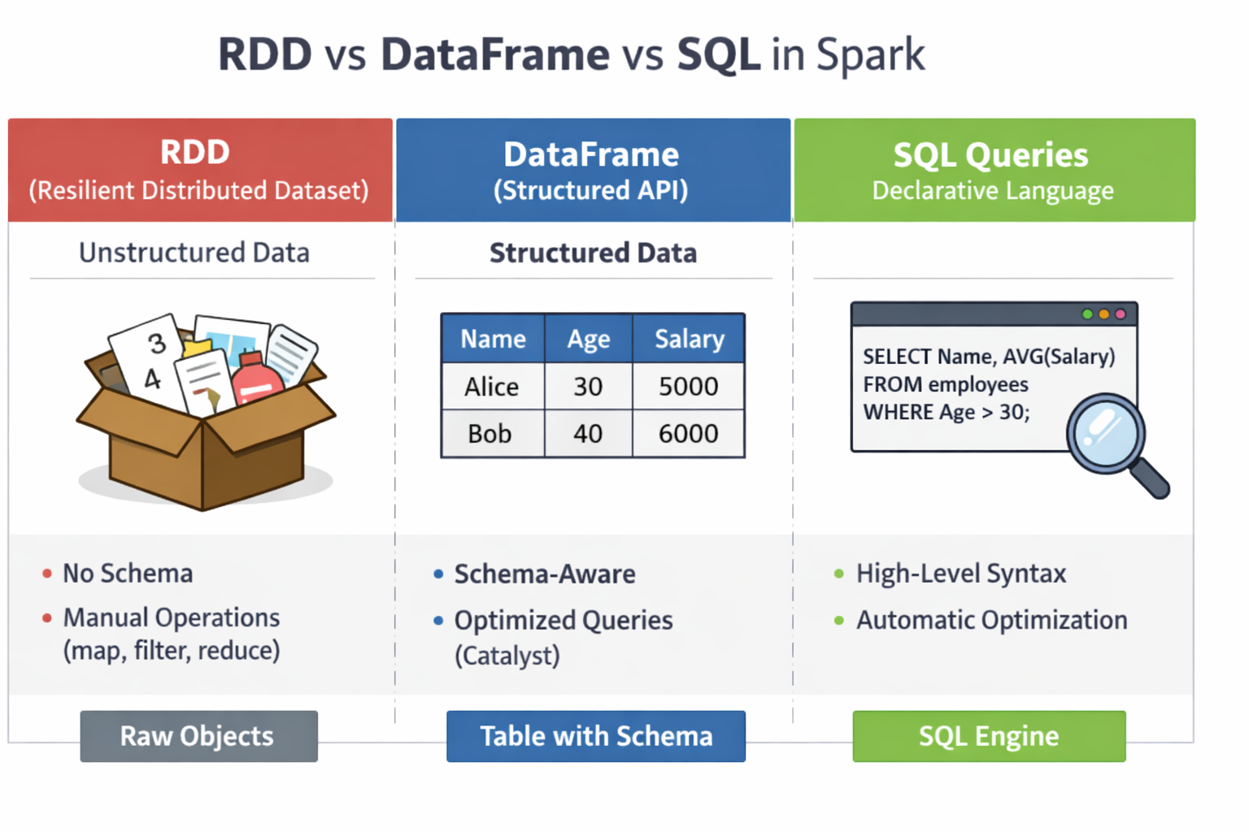
Notes:
RDDs are unstructured collections of objects. Spark doesn’t know the schema, so you must manually use map, filter, reduce.
DataFrames are structured tables with schema. Spark knows column names and types, enabling Catalyst Optimizer to rewrite queries.
SQL queries are declarative. You describe what you want, Spark decides how to execute it efficiently.
RDD = raw objects, DataFrame = schema-aware table, SQL = high-level declarative language

Slide 11
Dataframes operations
Basic dataframe operations examples
Select(): to pick columns
Filter() or where(): to narrow down data
Join(): to combine datasets
orderBy(*cols) or sort(*cols): Sorts rows by one or more columns.
distinct(): Returns unique rows.
groupBy(*cols): Groups data for aggregation.
union(): Appends rows from another DataFrame
show(n): Prints the first n rows in tabular format.
collect(): Retrieves all data to the driver node (use with caution for large datasets).
count(): Returns the total number of rows.
take(n) or head(n): Returns the first n rows as a list.
Notes:
df.select(col("Age") * 2).show()
where() is an alias for filter(), and both can be used interchangeably.
Available join types include: inner, left, right, outer.
Using aliases avoids column ambiguity and keeps queries readable.

Slide 12
Sparksql module
Spark SQL is a module in Apache Spark that lets you query structured and semi‑structured data using SQL syntax.
It provides a relational view of distributed data, similar to working with tables in a database.

Slide 13
Sparksql vs dataframe
Aspect | Spark SQL | DataFrame API
Interface | SQL queries via spark.sql() | Programmatic API in Scala, Python, Java, R
Ease of Use | Concise for complex queries | Flexible for dynamic logic
Audience | Analysts, BI users | Developers, data engineers
Integration | Hive, external DBs, SQL views | MLlib, streaming, programmatic workflows
Performance | Same Catalyst + Tungsten engine
Notes:
Both APIs generate a logical plan → optimized plan → physical plan → RDD execution.
Performance is identical because both use the Catalyst Optimizer and Tungsten Engine.
Choice depends on workflow style: SQL for declarative queries, DataFrame API for programmatic pipelines.

Slide 14
Sparksql: Query optimization
Spark SQL Optimization improves query performance and reduces resource usage
It is powered by the Catalyst Optimizer, which automatically rewrites queries for efficiency.
Catalyst uses:
Rule-based optimization (apply predefined rules)
Cost-based optimization (choose best plan based on cost)
Notes:
Core idea:
➡️ Spark does not execute queries immediately ➡️ It builds and optimizes an execution plan before running
Build → Optimize → Execute
User Query / DataFrame
│
▼
(Lazy Evaluation: No Execution)
│
▼
Optimized Execution Plan
│
▼
Result

Slide 15
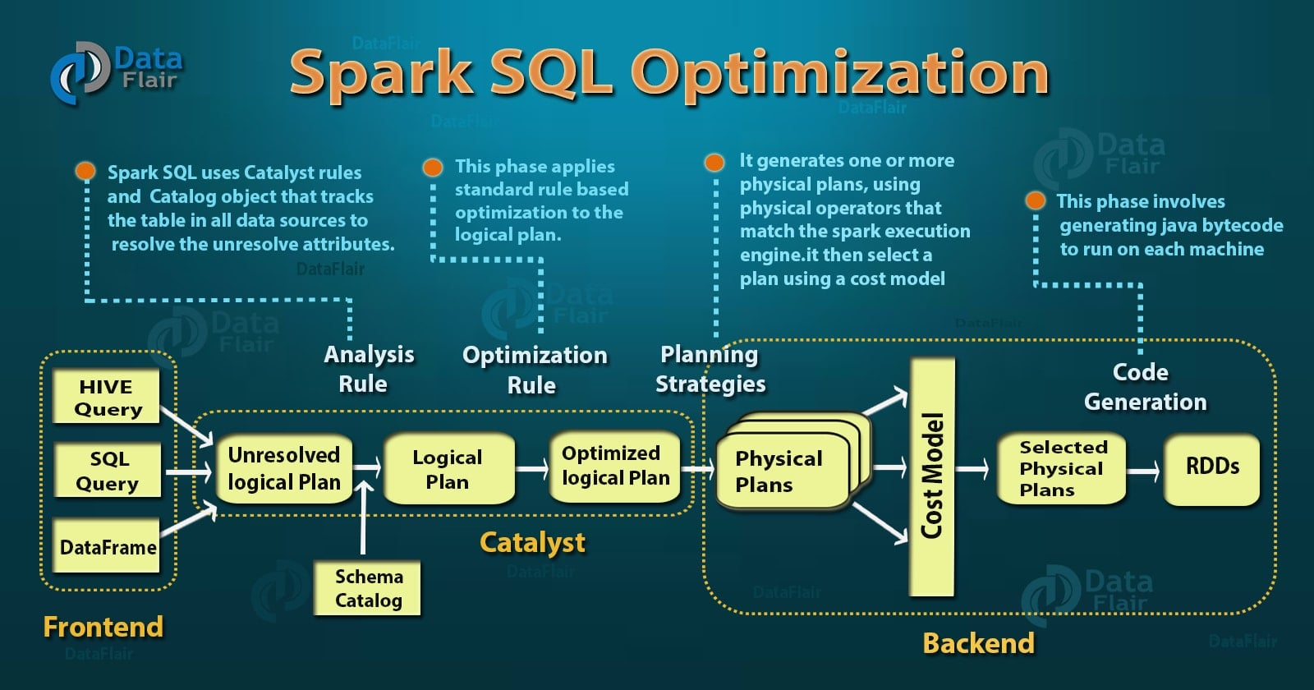
Notes:
https://data-flair.training/blogs/apache-spark-rdd-vs-dataframe-vs-dataset/
In Spark’s Catalyst Optimizer, “resolving attributes” refers to the process of matching column names and expressions in your query to actual fields in the dataset during query analysis.
When you write a query like
SELECT name, age FROM people WHERE age > 30
Spark first builds a logical plan, but at this stage, name and age are just symbols — Spark doesn’t yet know where they come from.
Attribute Resolution: Catalyst then resolves these attributes by checking the schema of the people DataFrame or table. It verifies that:
name and age exist in the dataset.
Their data types are compatible with the operations (e.g., age > 30 is valid because age is numeric).
Resolved Logical Plan:
After resolution, Spark replaces symbolic references with actual column objects tied to the dataset’s schema. This ensures the query is valid and ready for optimization.

Slide 16
Catalyst optimizer
Catalyst Optimizer is the core engine that powers query optimization in Spark SQL.
Built using functional programming principles in Scala, it leverages immutable data structures and pattern matching to transform queries efficiently.
It operates on a tree representation of queries — each node represents an operation (e.g., filter, join, aggregation).
Optimization Type | Description | Example
Rule-Based Optimization (RBO) | Applies deterministic rewrite rules to simplify queries. | Push filters before joins, remove redundant projections.
Cost-Based Optimization (CBO) | Uses statistics (row counts, data size) to choose the most efficient plan. | Selects join strategy (broadcast vs shuffle) based on data size.
Notes:
[SQL Query / DataFrame]
│
▼
[Analysis Phase]
(Resolve tables & columns)
│
▼
[Logical Optimization]
(Filter pushdown, pruning, etc.)
│
▼
[Physical Planning]
(Choose best execution plan)
│
▼
[Code Generation]
(Generate Java bytecode)
│
▼
[Execution]
Physical Planning: Catalyst generates multiple "Physical Plans" and uses a Cost-Based Optimization (CBO) model to select the most efficient one. It evaluates strategies for operations like joins (e.g., choosing a Broadcast Hash Join over a Sort Merge Join based on table size).
Catalyst Optimizer Step-by-Step
Parsing & Unresolved Logical Plan: Spark reads the SQL or DataFrame code and turns it into an Abstract Syntax Tree (AST), creating a plan with unresolved table/column references.
Analysis: Spark uses the Catalog (containing metadata) to resolve table and column names, verifying that requested columns exist and have the correct data types.
Logical Optimization: Rules are applied to optimize the plan. Key techniques include:
Predicate Pushdown: Filters are moved as close to the data source as possible (e.g., WHERE clauses).
Column Pruning: Unused columns are removed early, reducing I/O.
Constant Folding: Expressions like 2 + 2 are pre-computed to 4.
Physical Planning: The optimized logical plan is converted into several physical plans, which are evaluated for efficiency (Cost-Based Optimization).
Code Generation: The final physical plan is compiled into Java bytecode (Tungsten) for fast execution at runtime.

Slide 17
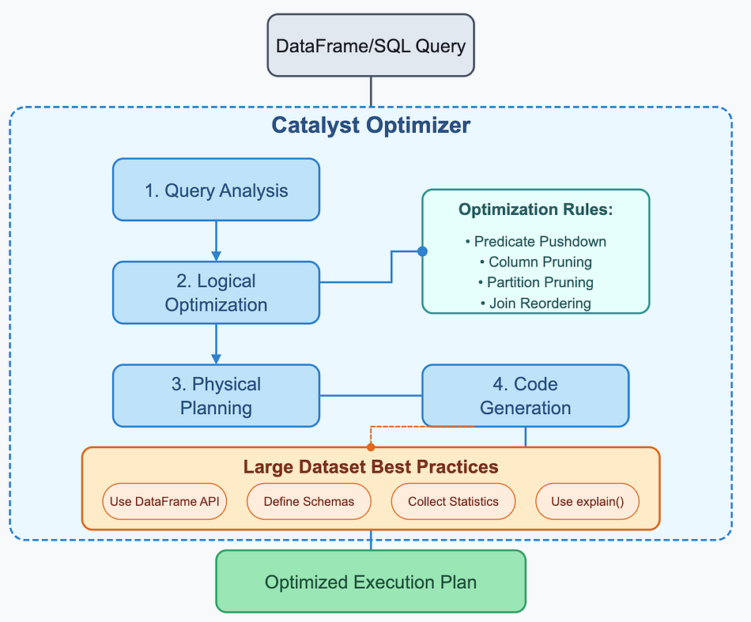
Catalyst: The Optimization Pipeline
Query Analysis
Resolve tables & columns
Logical Optimization
Predicate pushdown
Column pruning
Constant folding
Physical Planning
Generate multiple plans
Choose best plan (cost-based)
Code Generation
Convert plan to optimized bytecode
Output: Efficient execution plan
Notes:
Image source: https://medium.com/@badrish.davay/apache-spark-catalyst-optimizer-in-nutshell-570926e0ac79
🔍 What It Does
Rewrites queries into more efficient forms.
Eliminates unnecessary operations (e.g., redundant filters or projections).
Pushes computation closer to data (predicate pushdown).
Chooses optimal join strategies (broadcast, sort-merge, shuffle hash).
Generates execution plans that minimize I/O and maximize parallelism.
------------------------------------------------------------------------------------------------------------------------------------------------------------------------------
Query Analysis
unresolved attribute, it means we don’t know its type or have not matched it to an input table. Spark SQL make use of Catalyst rules and a Catalog object that track data in all data sources to resolve these attributes. It starts by creating an unresolved logical plan, and then apply the following steps:
Search relation BY NAME FROM CATALOG.
Map the name attribute, for example, col, to the input provided given operator’s children.
Determine which attributes match to the same value to give them unique ID.
Propagate and push type through expressions.
-------------------------------------------------------------------------------------------------------------------------------------------
Logical Optimization
After resolving column references and data types, Catalyst applies a series of rule-based optimizations to the logical plan:
Constant folding: Evaluates expressions with constant values at compile time
Predicate pushdown: Filters data as early as possible in the pipeline
Column pruning: Drops unnecessary columns to reduce data transfer
Partition pruning: Skips irrelevant partitions based on filter conditions
Join reordering: Arranges joins to minimize intermediate result sizes
------------------------------------------------------------------------------------------------------------------
Physical Planning
The logical plan is then converted into multiple physical plans. Each physical plan represents a different way to execute the query using the available physical operators like broadcast joins, sort-merge joins, and various aggregation strategies.
Catalyst evaluates these physical plans using its cost model, which considers factors like:
Data size and distribution
Available resources
Operation complexity
Statistics about the data
The plan with the lowest estimated cost is selected for execution. --------------------------------------------------------------------------------------------------------------
Code Generation
Finally, Spark generates efficient JVM bytecode for the selected plan using a technique called whole-stage code generation. This step collapses multiple operations into a single function wherever possible, reducing virtual function calls and optimizing CPU usage.

Slide 18
Logical plan optimization
Predicate pushdown
Moves filtering as close to the data source as possible
Removes irrelevant rows early
Example: Instead of reading all sales data:
“SELECT * WHERE country = 'Egypt'”
Spark filters data before loading fully into memory
Benefit:
Reduces data scanned from storage
Less disk I/O
Faster query start
Notes:
Large Dataset
│
┌─────────┼─────────┐
▼ ▼ ▼
Filter Select Join Opt
Pushdown Columns Strategy
│ │ │
└─────────┴─────────┘
▼
Less Data Processed
▼
Faster Execution

Slide 19
Logical plan optimization
Column Pruning
Loads only required columns, not full table
Example: If query needs specific columns like product_id, price
Spark will NOT load unnecessary columns data such as:
customer_name, address, timestamps
Benefit:
Less memory usage
Faster serialization/deserialization
Reduced network transfer in cluster
Notes:
Large Dataset
│
┌─────────┼─────────┐
▼ ▼ ▼
Filter Select Join Opt
Pushdown Columns Strategy
│ │ │
└─────────┴─────────┘
▼
Less Data Processed
▼
Faster Execution

Slide 20
Logical plan optimization
Join Optimization Strategy
Spark chooses the best join method based on data size:
Common strategies:
Broadcast Join → small table sent to all nodes
Shuffle Hash Join → partition-based join
Sort Merge Join → for large sorted datasets
Benefit:
Avoids expensive shuffling
Reduces network overhead
Speeds up distributed joins
Notes:
🔹 1. Broadcast Join
Concept: Spark sends a small table to all worker nodes so each node can join it locally with its partition of the large table.
How it works:
Spark copies the small dataset (called the broadcasted table) to every executor.
Each executor performs the join without shuffling the large dataset.
This avoids expensive network transfers.
When to use:
One table is tiny (usually < 10 MB).
Common in lookups or dimension joins (e.g., joining customer data with country codes).
Benefit:
Fastest join type when one dataset is small.
No shuffle, minimal network overhead.
-----------------------------------------------------------------------------------------------
🔹 2. Shuffle Hash Join
Concept: Spark partitions both datasets by the join key, then performs a hash-based join on each partition.
How it works:
Each dataset is shuffled so that rows with the same join key end up on the same node.
Spark builds a hash table for one dataset and probes it with the other.
Works well when both datasets fit in memory after partitioning.
When to use:
Both datasets are moderately large and not sorted.
The join keys are evenly distributed (no data skew).
Benefit:
Efficient for medium-sized data.
Parallel execution across partitions.
Drawback:
Requires shuffling, which can be costly if data is unevenly distributed.
-------------------------------------------------------------------------------
🔹 3. Sort Merge Join
Concept: Spark sorts both datasets by the join key, then merges them efficiently — similar to merging two sorted lists.
How it works:
Each dataset is sorted on the join key.
Spark scans both sorted datasets simultaneously, matching keys as it goes.
Ideal for large, already sorted data (like time-series or range joins).
When to use:
Both datasets are large and already sorted or can be sorted efficiently.
Common in ETL pipelines or joins on timestamp/range columns.
Example: Joining two 100 GB logs on timestamp.
Benefit:
Handles very large datasets.
Efficient when data is pre-sorted.
Works well with range joins.
Drawback:
Sorting is expensive if data isn’t already sorted.
More memory-intensive than broadcast joins.

Slide 21
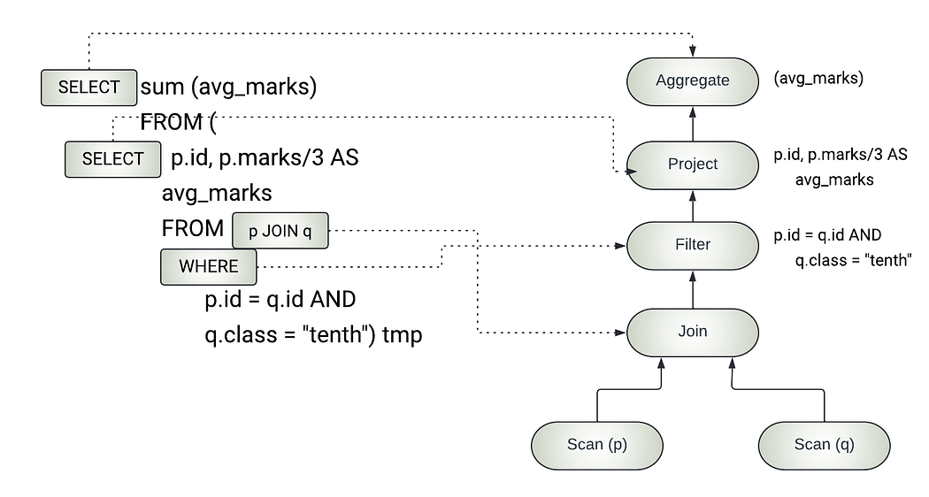
Notes:
https://medium.com/@sharanharsoor/optimization-in-spark-ca3b75f5cffe
logical plan that is generated from a user program

Slide 22
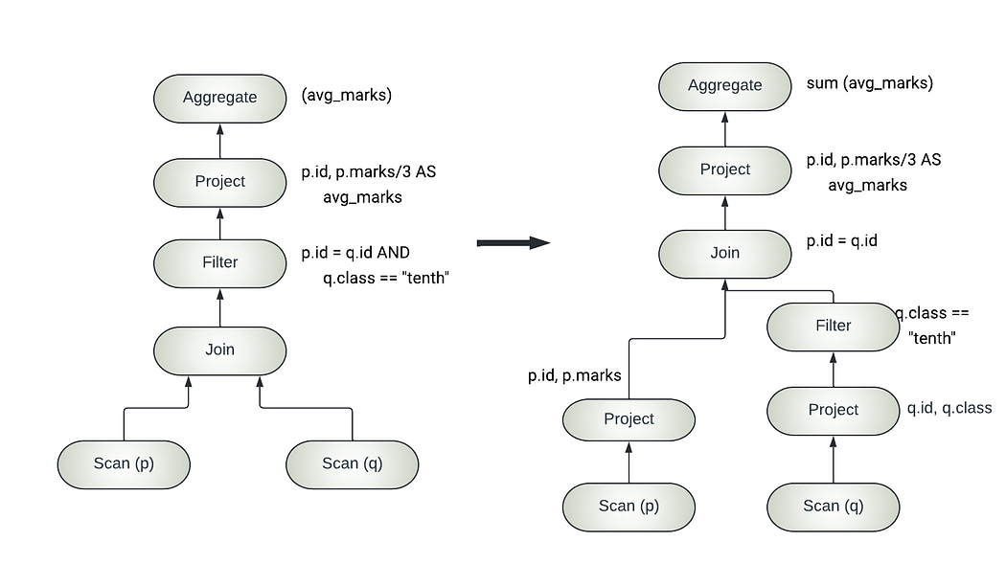
Notes:
Catalyst optimized plan

Slide 23
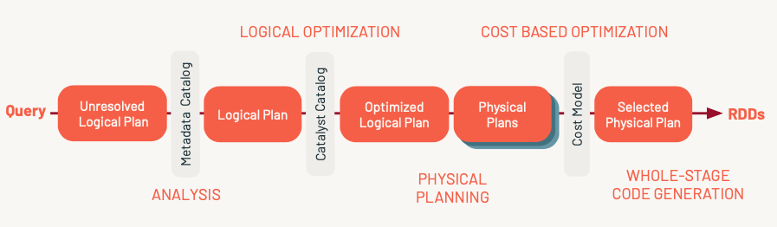
From Logical Plan to RDD Execution
DataFrame/SQL Code → Logical Plan → Optimized Logical Plan → Physical Plan → RDD Transformations → Execution
Notes:
https://medium.com/towards-data-engineering/understanding-rdds-in-apache-spark-the-foundation-of-distributed-computing-b6becac1de43
Step 1: Create Logical Plan
When you write DataFrame or SQL code, Spark builds a logical plan.
This plan is a tree representation of what you want to compute, not how.
It’s lazy — no data is processed yet.
Step 2: Optimize Logical Plan
Spark’s Catalyst Optimizer applies transformation rules to improve efficiency.
Common optimizations:
Predicate Pushdown → filters applied early
Column Pruning → only needed columns read
Constant Folding → pre‑computes constants
Join Reordering → minimizes shuffle and data movement
Result: an optimized logical plan ready for execution planning.
Step 3: Generate Physical Plan
Spark converts the optimized logical plan into a physical plan.
This defines how computations will run:
Partitioning strategies
Narrow vs. wide dependencies
Shuffle operations
Multiple physical plans may be tested; Spark picks the most efficient one.
Step 4: Translate to RDD Operations
The chosen physical plan is translated into RDD transformations.
Spark records lineage (the dependency chain of RDDs).
At this stage, everything is expressed as RDD operations like map, filter, reduceByKey.
Step 5: Execution
When an action (e.g., count(), show()) is triggered, Spark executes the RDD lineage.
Tasks are distributed across the cluster, and results are computed.

Slide 24
Dag scheduler vs. catalyst optimizer
1. Catalyst Optimizer: The "What"
Catalyst is a Query Optimizer. It only exists for Structured APIs (DataFrames, Datasets, and SQL). Because it understands the Schema (column names and types), it can rewrite your logic to be more efficient.
When it runs: Before the execution starts (during the planning phase).
Key Optimizations:
Predicate Pushdown
Column Pruning
Constant Folding

Slide 25
Dag scheduler vs. catalyst optimizer
2. DAG Scheduler: The "How"
The DAG Scheduler is a Task Scheduler. It exists for everything in Spark (including low-level RDDs). It cares about Dependencies (where the data is and where it needs to go).
When it runs: After the logical plan is finalized, right when an Action is called.
What it sees: A graph of RDD dependencies.
Key Optimizations:
Stage Splitting: Identifying "Shuffle Boundaries" (Wide Dependencies) to break the job into stages.
Pipelining: Combining multiple "Narrow" operations (like Map and Filter) into a single Stage so the data stays in the CPU cache and doesn't hit the RAM/Disk unnecessarily.
Task Generation: Creating the actual task objects that get sent to the Worker Nodes

Slide 26
Dag scheduler vs. catalyst optimizer
How they work together?
DataFrame Code: You write a query.
Catalyst (The Brain): Looks at the schema, moves filters around, and produces an Optimized Logical Plan. It then turns this into a physical plan (a set of RDDs).
DAG Scheduler (The Muscle): Takes those RDDs, groups them into Stages, and hands them to the Task Scheduler.
Executors: Run the tasks on the actual data partitions.

Slide 27
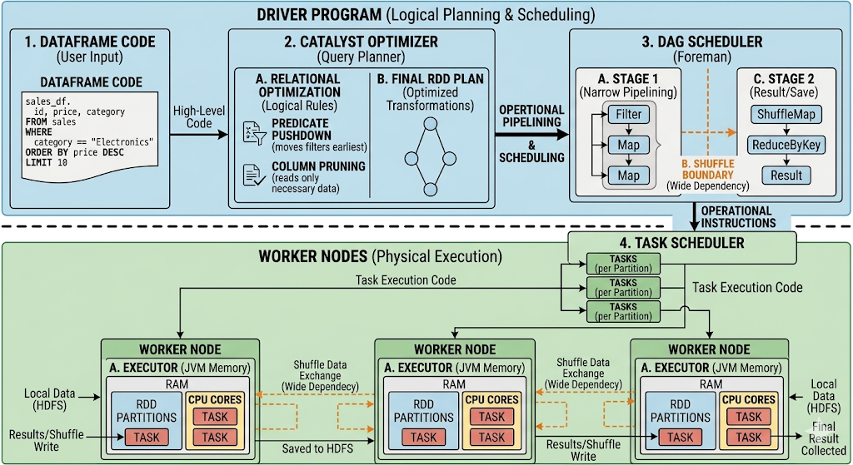

Slide 28
Dag scheduler vs. catalyst optimizer
Feature | Catalyst Optimizer | DAG Scheduler
Primary Goal | Optimize Logic (The "What"). | Optimize Execution (The "How").
Understands Data? | Yes (via Schema/Types). | No (sees data as generic objects).
Output | An optimized physical plan (RDDs). | A set of Stages and Tasks.
Main Trick | Predicate Pushdown / Column Pruning. | Stage Pipelining / Task Scheduling.

Slide 29
RDDs vs DataFrames: Choosing the Right Abstraction
Aspect | RDDs | DataFrames
Data Type | Unstructured or semi‑structured collections of objects | Structured, tabular data with schema
Control Level | Low‑level, fine‑grained transformations | High‑level, declarative operations
Optimization | Manual tuning required | Automatic via Catalyst Optimizer
Ease of Use | Verbose and complex | Simple, SQL‑like syntax
Performance | Less efficient, no query optimization | Highly optimized execution
Best For | Custom algorithms, unstructured data, specialized control | Analytical, ETL, and SQL‑style workloads
Notes:
RDDs → offer flexibility and control but require manual optimization.
DataFrames → provide structure, automatic optimization, and ease of use.
In modern Spark, DataFrames (and Spark SQL) are the default choice; RDDs are reserved for niche, low‑level tasks.

Slide 30
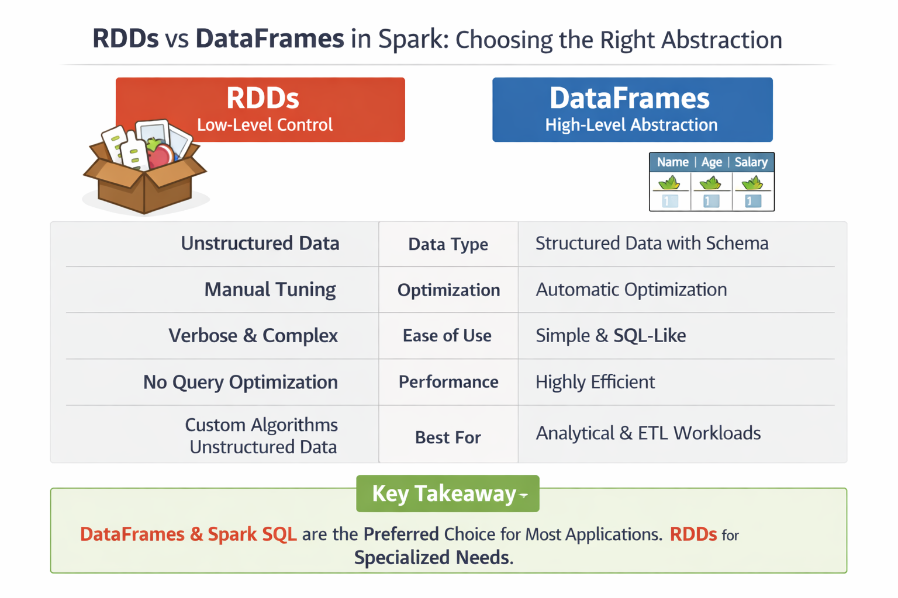
Notes:
RDDs → offer flexibility and control but require manual optimization.
DataFrames → provide structure, automatic optimization, and ease of use.
In modern Spark, DataFrames (and Spark SQL) are the default choice; RDDs are reserved for niche, low‑level tasks.

